Slide 1



Water Quality Prediction
Prajan Kannan
AICTE Internship Student Registration ID :
STU66ee8be6e60f11726909414
AICTE Internship ID :
INTERNSHIP_1746416864681834e0e35d8

Slide 2

Learning Objectives
Preprocessing real-world environmental datasets, date parsing, missing value handling and feature engineering.
Apply multi-output regression techniques using ensemble models like Random Forest.
Implement model training, evaluation (MSE, R²), and performance reporting for multiple dependent variables.
Visualize model predictions using confusion matrix and accuracy metrics for WQI classification.
Explore environmental data science applications using machine learning for real-world impact.
GOAL

Slide 3
Tools and Technology used
Python as programming language
Numpy and Pandas for data handling and manipulation
Matplot and Seaborn for data visualization
Scikit-learn and RandomForestRegressor with MultiOutputRegressor for ML
MSE, R² and Confusion Matrix for Model Evaluation
Joblib to save the model
Google Colab for execution

Slide 4
Methodology
Data Collection & Import Real-world water quality dataset was loaded using pandas. Dataset includes timestamped records from multiple water monitoring stations.
Data Preprocessing Converted date strings to datetime objects and extracted year and date. Removed rows with missing values in key pollutant columns. One-hot encoded categorical station IDs for machine learning compatibility.
Target Selection Target variables included six major pollutants: O₂, NO₃, NO₂, SO₄, PO₄, and CL. These pollutants were modeled as continuous variables for regression.

Slide 5
Methodology
Water Quality Index (WQI) Computation Implemented formula-based WQI calculation using weighted quality ratings based on ideal and permissible limits. Classified WQI values into quality classes: Excellent, Good, Poor and Not Suitable
Model Development Used a Random Forest Regressor wrapped in MultiOutputRegressor to simultaneously predict all pollutant levels. Split data into training and testing subsets (80:20 split) and training the model on encoded and scaled inputs.

Slide 6
Methodology
Model Evaluation Evaluated per-pollutant performance using Mean Squared Error (MSE) and R² score. Computed WQI from predicted pollutant levels and compared to actual WQI class. Displayed a confusion matrix for WQI class prediction.
Sample Validation Generated random sample reports to compare predicted vs actual pollutant values and WQI classes for real-world interpretation.
Model Persistence Saved the trained model, feature scaler, and input feature structure using joblib for deployment or reuse.

Slide 7
Problem Statement
Ensuring access to clean and safe water is a global priority, yet real-time monitoring and prediction of water quality parameters remains a challenge due to environmental complexities and data variability. The problem this project addresses is:
“” Can we accurately predict multiple key water pollutants and classify overall water quality using machine learning models, based on historical monitoring data from various water bodies? ”” This involves :
Predicting levels of major pollutants like O₂, NO₃, NO₂, SO₄, PO₄, and CL.
Computing a reliable Water Quality Index (WQI) based on these predictions.
Classifying water quality into actionable categories (e.g., Excellent, Good, Poor).
Providing a model that generalizes well across monitoring stations and years.

Slide 8
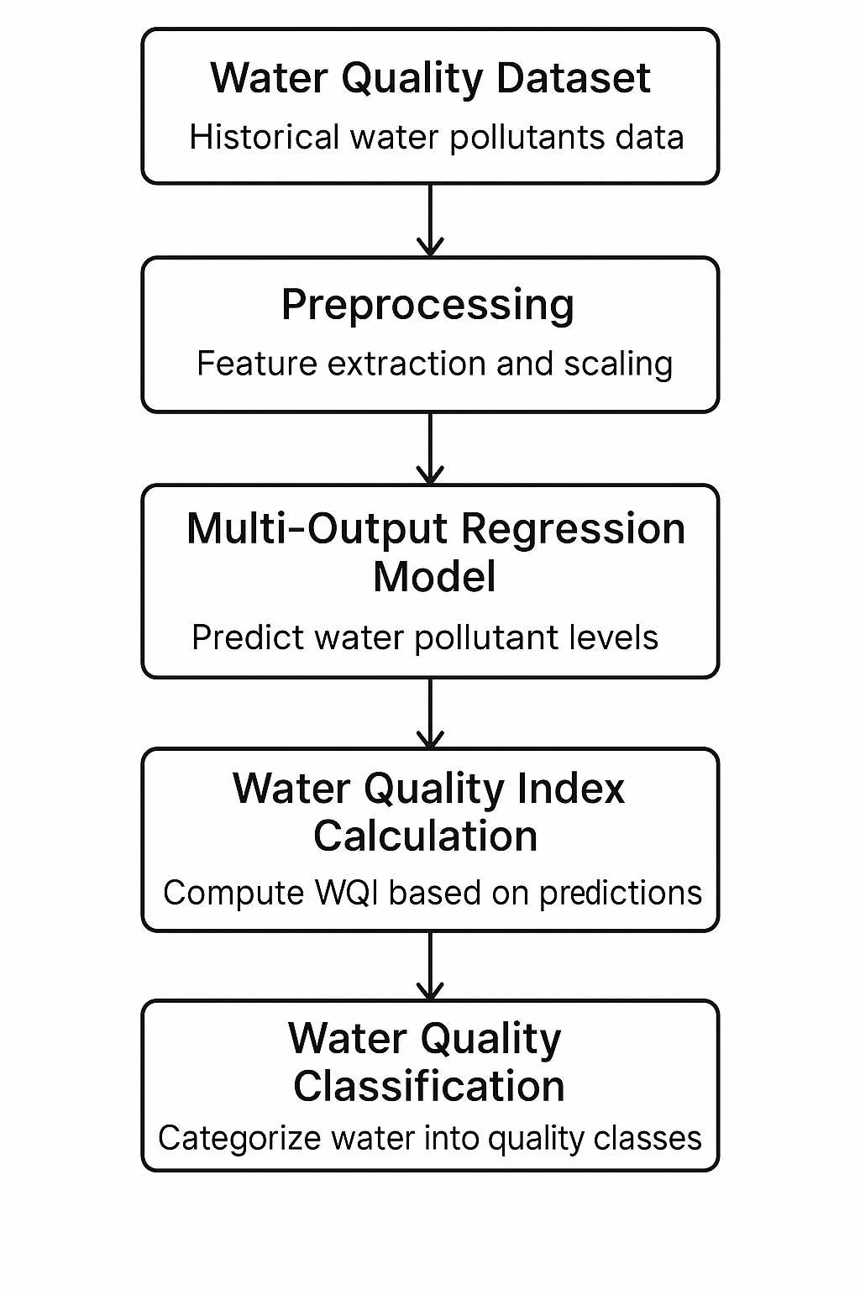
Solution

Slide 9
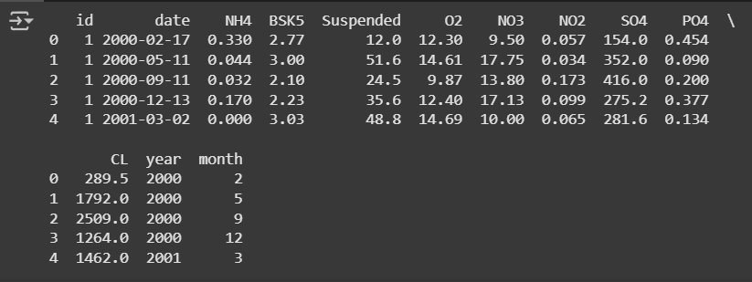
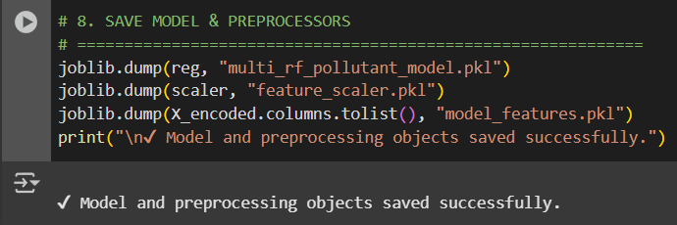
Screenshot of Output

Slide 10
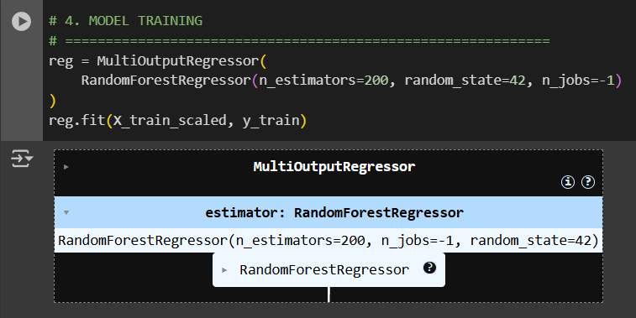
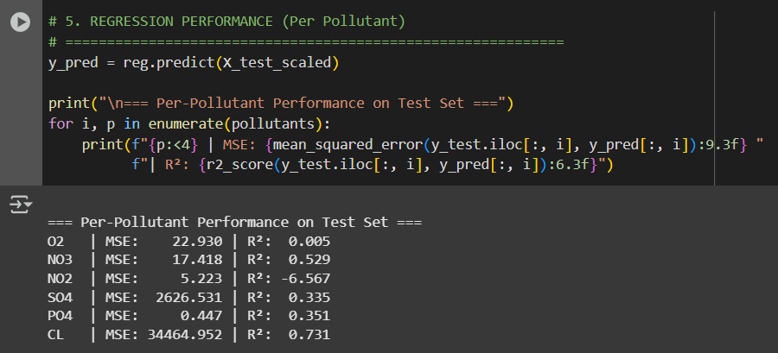

Slide 11
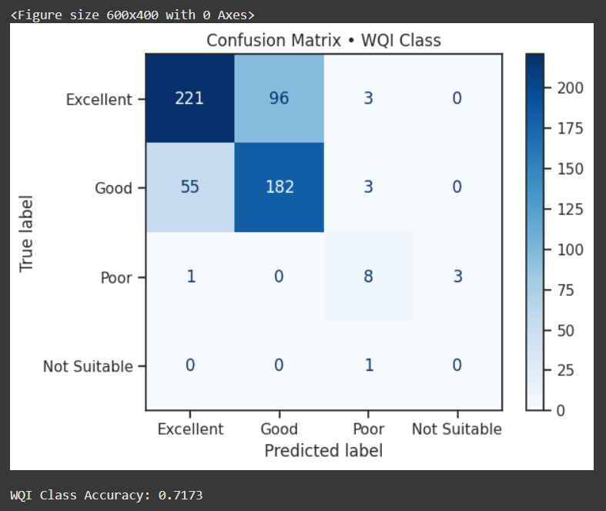

Slide 12
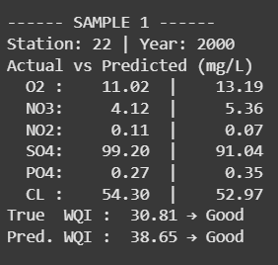
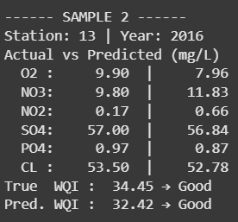
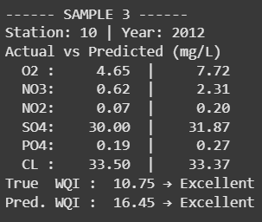
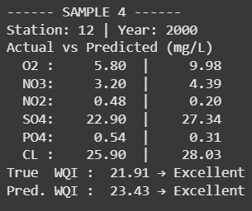
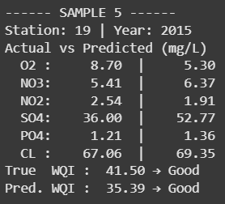

Slide 13
Conclusion
This project showcases the effective use of machine learning for multi-target regression in forecasting essential water quality parameters.
Using historical datasets along with relevant domain-specific metrics such as the Water Quality Index (WQI), predicting concentration of pollutants and classifies the overall water quality into tiered categories (e.g: Excellent, Good, etc.).
The reliability of the Random Forest-based multi-output model was robust; its integration with SHAP explainability enhanced understanding of feature impact, thus enabling its application in environmental monitoring and informed decision-making.

